Slide 1
JOB ROTATION,ENLARGEMENT AND ENRICHMENT
Session 31

Slide 2
Job rotation
Job rotation is a strategy where employees rotate between jobs at the same business. Employees take on new tasks at a different job for a period of time before rotating back to their original position. With a job rotation system, employees gain experience and skills by taking on new responsibilities.

Slide 3
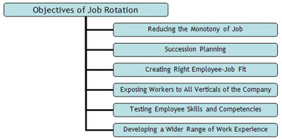

Slide 4
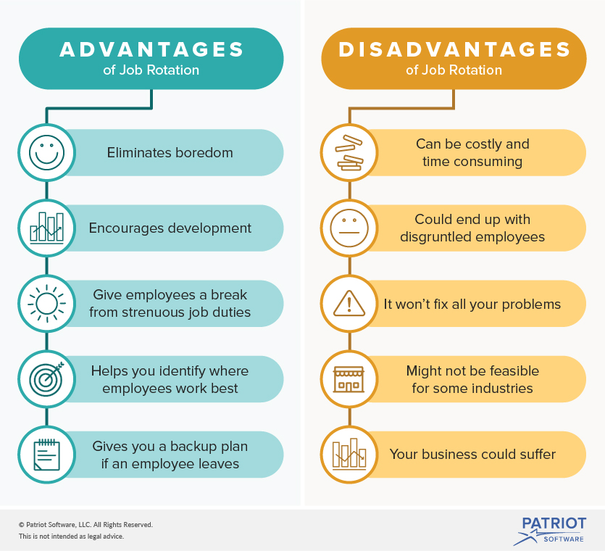

Slide 5
Example
For example, a person initially employed in the engineering department to create new products may work for several years in the marketing department, to see how products are positioned and advertised in the marketplace, and then move on to the sales department to experience the selling process flow. Other rotations might send the individual through the production and accounting departments, to gain a more complete understanding of the remaining key functional areas. Only after this job rotation has been completed will the employee be shifted into a senior management position. Even after achieving a senior post, an employee might still be rotated through other senior jobs, in preparation for taking over the chief operating officer or chief executive officer positions.

Slide 6
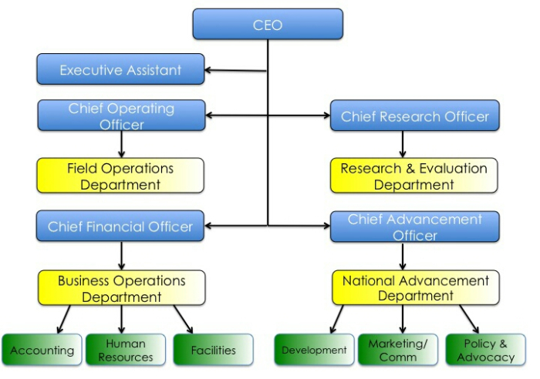

Slide 7
Job Enlargement
Job enlargement means increasing the scope of a job through extending the range of its job duties and responsibilities generally within the same level and periphery. Job enlargement involves combining various activities at the same level in the organization and adding them to the existing job.

Slide 8
Objectives of job enlargement
The objective of job enlargement is to motivate an employee by increasing his efforts and exposure towards achieving the organizational objectives as set for the job. By doing this, an employee can get a wider range of his or her objectives without his or her job in a repetitious manner.

Slide 9
Advantages
Some advantages of job enlargement are a variety of skills, improves earning capacity, and wide range of activities.
Variety of skills – Job enlargement helps the organization to improve and increase the skills of the employee due to organization as well as the individual benefit.
Improves earning capacity – with all the new activities a person learns from job enlargement, they are able to try to get a better salary when they apply for a new job.
Wide range of activities – Employees are able to learn more activities which can help a company save money by reducing the number of employees they have.

Slide 10
Disadvantage
However results have shown that this process can see its effects diminish after a period of time, as even the enlarged job role become the mundane, this in turn can lead to similar levels of demotivation and job dissatisfaction at the expense of increased training levels and costs. The continual enlargement of a job over time is also known as 'job creep', which can lead to an unmanageable workload.

Slide 11
Example
If Mr. A is working as an executive with a company and is currently performing 3 activities on his job after job enlargement or through job enlargement we add 4 more activities to the existing job so now Mr. A performs 7 activities on the job.
It must be noted that the new activities which have been added should belong to the same hierarchy level in the organization. By job enlargement we provide a greater variety of activities to the individual so that we are in a position to increase the interest of the job and make maximum use of employee’s skill.

Slide 12
Job Enrichment
Job enrichment is a common motivational technique used by organizations to give an employee greater satisfaction in his work. It means giving an employee additional responsibilities previously reserved for his manager or other higher-ranking positions.
Job enrichment involves organizing and planning in order to gain more control over their duties and work as a manager. The execution of plans and evaluation of results motivates workers and relieves boredom.

Slide 13
Advantages
Useful to both employee and organization
Achievement, recognition and self-actualization
Sense of belonging
Finds the job meaningful
Reduces absenteeism, turnover and grievances
Motivates employees to give best performances

Slide 14
Disadvantages
In many cases it may not give expected results.
Workers may oppose many changes in the job
It has limited use for highly skilled managers and professionals. This is because their jobs are already challenging.
The consent of workers is not taken before implementing job enrichment

Slide 15
Example
Members of a team are given a task and a budget and asked to sort out for themselves how to achieve the task. This technique also has value as a learning and development tool and can allow managers to identify high-potential staff and future leaders. An example is when a consultancy encourages junior staff to pitch for low-value new business.

